Slide 1

DATA 7901
DATA SCIENCE CAPSTONE PROJECT
Deep Learning Probabilistic Forecasting
on Time-Series Sales Data
Presented by: Beatrice Carrol Que

Slide 2
Contents
Background
Long Short Term Memory Network
LSTM Applied
LSTM in Python
LSTM Evaluation
Recommendations
Notes:
Other information
-

Slide 3
M5 Forecasting Competition
Walmart Sales Data
Walmart
CA
TX
WI
Store 1
Store 2
Store 3
Hobbies
Category 2
Hobbies_1
Hobbies_2
424 items
149 items
Notes:
Other information
-

Slide 4
M5 Forecasting Competition
Walmart Sales Data
Walmart
All Data: | 1,969 days
Training | 1,913 days
Validation | 28 days
Test | 28 days
CA
TX
WI
Store 1
Store 2
Store 3
Hobbies
Category 2
Hobbies_1
Hobbies_2
424 items
149 items
Notes:
Other information
-

Slide 5
M5 Forecasting Competition
Other Data
Date
Events
Weekday
Event Type
Month
SNAP
Year
Item Prices
** Snap days – days when stores accept food stamps for purchases
Notes:
Other information
-

Slide 6
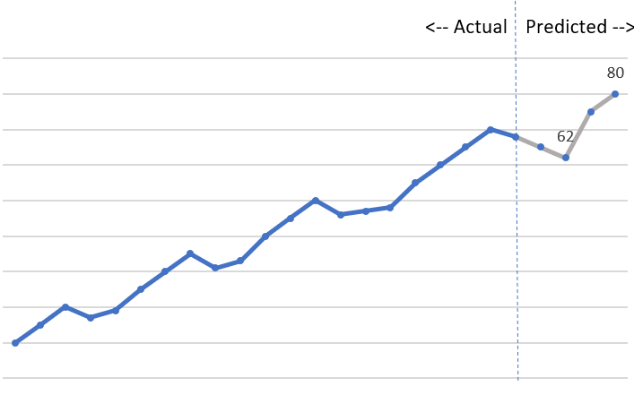
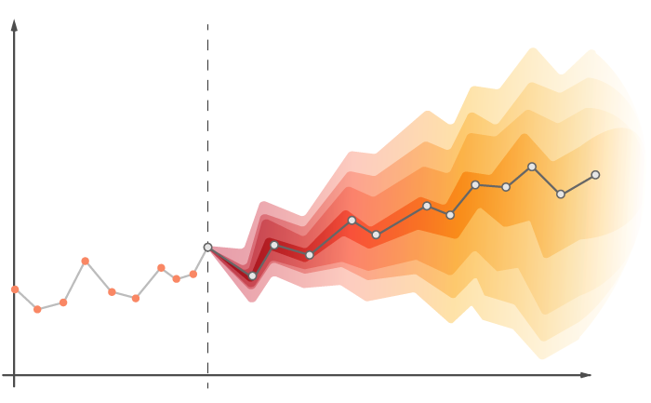
M5 Forecasting Competition
Accuracy Competition
Prediction:
Point Estimate
Uncertainty Competition
Prediction:
Probabilistic
Different
Quantiles
Notes:
Source:
https://medium.com/atoti/using-atoti-to-leverage-probabilistic-time-series-forecasts-from-a-deep-learning-model-af293493be78

Slide 7
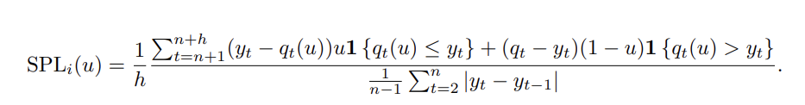
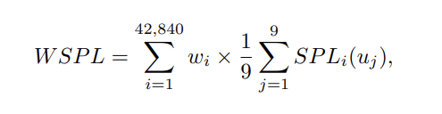
Model Evaluation
Numerator:
If predicted < actual:
(actual-predicted) * quantile
If actual < predicted:
(predicted – actual) * (1-quantile)
Average SPL of 9 quantiles * weight for the series
Lower WSPL = better results

Slide 8
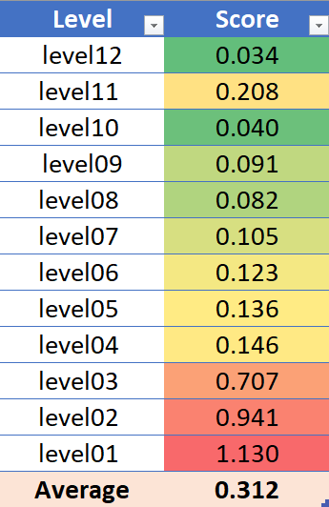
Probabilistic Forecasting
Benchmark:
ARIMA (Bottom-Up)

Slide 9
Long Short Term Memory Network
(LSTM)
Pass information from previous prediction
(weights, bias, activation function, etc.)
- Select
- Forget
- Ignore
Output 1
Output 2
Output 3
Output n
H
H
H
H
Hidden State
Input
Predicted
Input 1
Input 2
Input 3
Input n

Slide 10
Long Short Term Memory Network
(LSTM)
Pass information from previous prediction
(weights, bias, activation function, etc.)
Output 1
Output 2
Output 3
Output n
H
H
H
H
Hidden State
Input
Predicted
Input 1
Input 2
Input 3
Input n

Slide 11
LSTM Applied to Walmart Sales
- Select
- Forget
- Ignore
Day 2
Day 3
Day 4
Day 28
H
H
H
H
Hidden State
Day 1 – 27 sales
Predict Day 28 sales
Day 1
Day 2
Day 3
Day 27

Slide 12
Multivariate LSTM
Using other data as input variables
Input Stack
Day 1 – 27 Sales
- Select
- Forget
- Ignore
Day 1 – 27 Var 1
Hidden State
Day 1 – 27 Var 2
Input
Predict Day 28 sales
Day 1 – 27 Var n

Slide 13
Multivariate LSTM
Input Stack
- Select
- Forget
- Ignore
Day 1 – 27 Sales
Day 1 – 27 Dates
Hidden State
Input
Predict Day 28 sales
Day 1 – 27 Events
Day 1 – 27 SNAP

Slide 14
Multivariate LSTM
Days 1 - 30
Model
Day 31
Day 2 - 31
Model
Day 32
Day 3 - 32
Model
Day 33

Slide 15
LSTM in Python
Model set-up
To be determined using validation
Package: Keras
Optimiser: Adam
Features
Batch size
Model: Sequential
Layers: 50
N steps
Activation: relu
Number of outputs: 1
Epoch
Loss: customised
** Loss is customized based on quantile to provide probability predictions

Slide 16
LSTM in Python
Feature Selection
Trend Analysis
RF Feature Importance
Model Validation

Slide 17
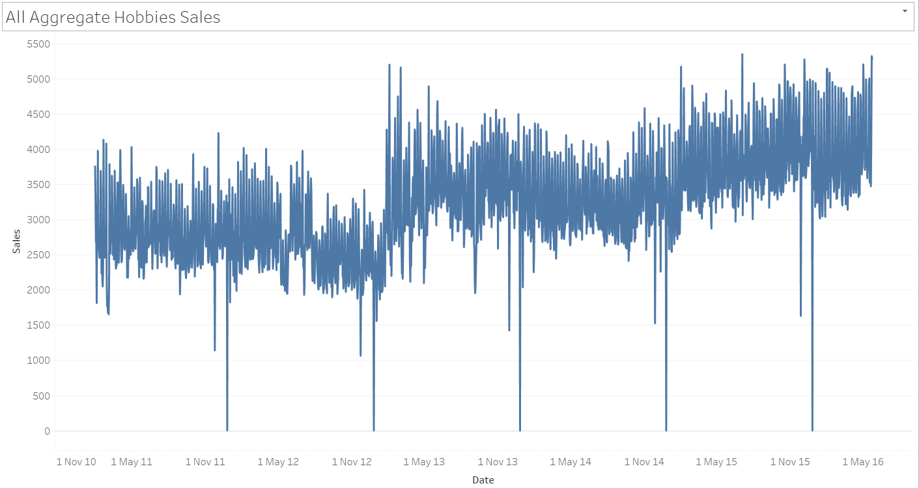
Feature Selection

Slide 18
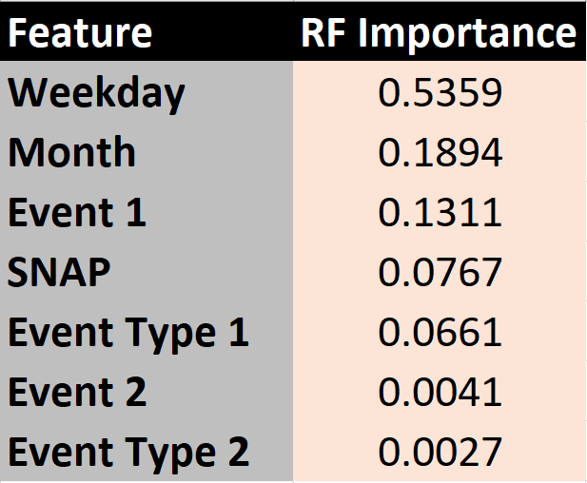
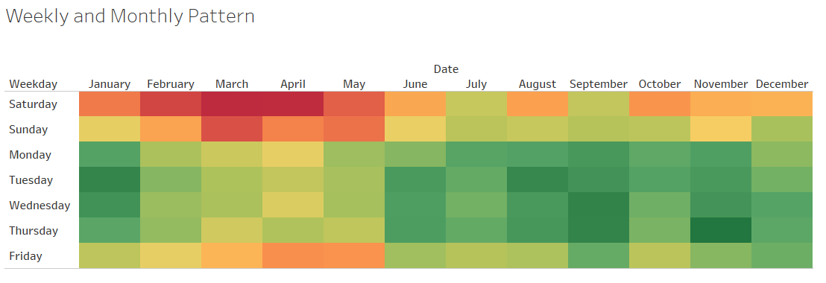

Feature Selection

Slide 19
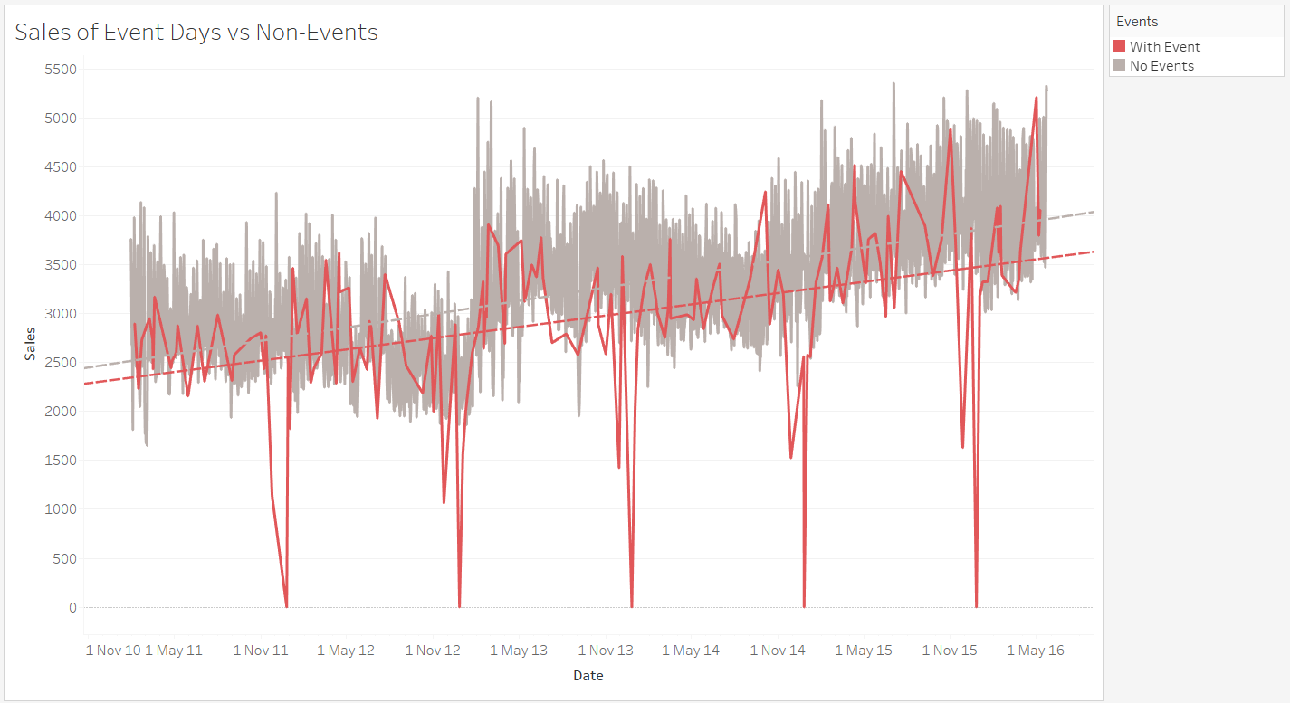
Feature Selection

Slide 20
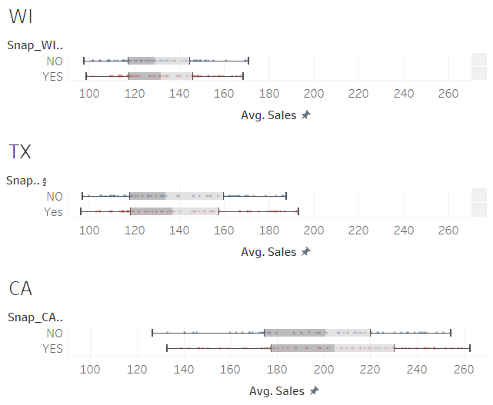
Feature Selection

Slide 21
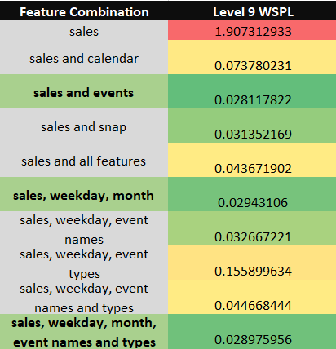
Feature Selection

Slide 22
LSTM in Python
Model set-up
To be determined using validation
Package: Keras
Optimiser: Adam
Features
Batch size
Model: Sequential
Layers: 50
N steps
Activation: relu
Number of outputs: 1
Epoch
Loss: customised
** Loss is customized based on quantile to provide probability predictions

Slide 23
Parameter Tuning
N steps
# of days
Input (X)
Input Stack
Days 1 - 10
Sales
Days 2 - 11
Dates
Days 3 - 12
Events
SNAP
Day 18 - 27

Slide 24
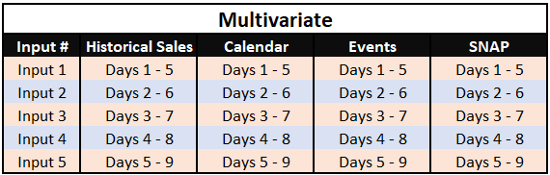
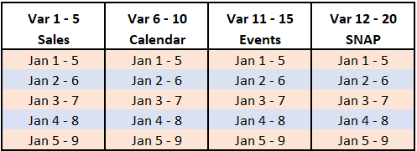

Slide 25
Parameter Tuning
Batch size
Input (X)
Output (y)
Days 1 - 10
Day 11
Days 2 - 11
Days 12
Days 3 - 29
Days 13
Day (k-27) - k
Day k+1

Slide 26
Parameter Tuning
Epoch
1 epoch
3 samples of 10 steps
# of samples
3 samples of 10 steps
Batch size
3 samples of 10 steps
3 samples of 10 steps

Slide 27
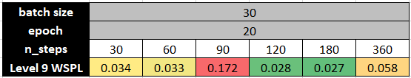
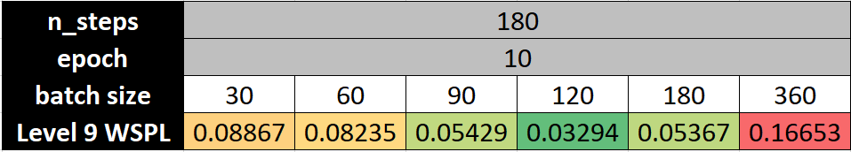
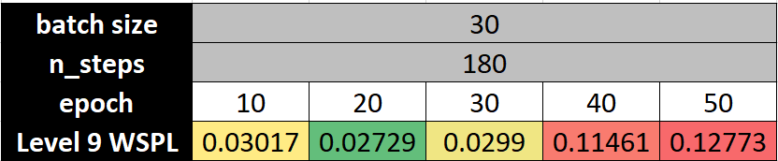
Parameter Tuning

Slide 28
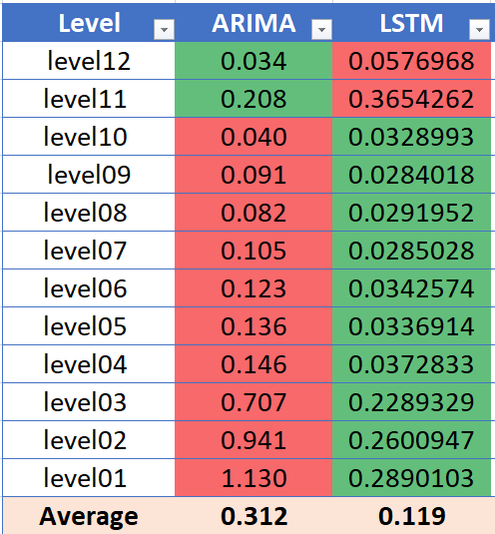
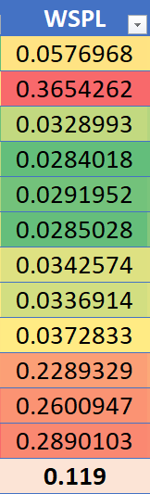
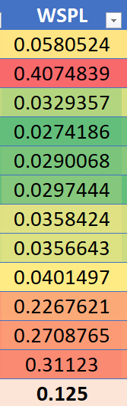
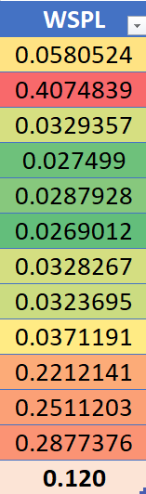
Sales, weekday, month, events
Sales, weekday, month
Sales, events
LSTM

Slide 29
LSTM vs. ARIMA
62% improvement over ARIMA

Slide 30
Recommendations
Results for bottom-up LSTM starting from level 12 upwards and utilize item prices
Compare different activation functions, optimizers, and number of layers
Accuracy of model on different categories
Results for all categories compared to winning methods

Slide 31
QUESTIONS?

